Slide 1

MediDiagnose
An Expert System for Medical Diagnosis Using
Logic Programming and Knowledge Representation Techniques
Course: CSE440 | Section: 1 | Faculty: MSRb | Group: 3
GROUP MEMBERS:
WASIUL ISLAM (172115042)
MD. JARIF MEHTAB HOSSAIN (2111216642)
MD. SAJIDUL ISLAM (2212663042)
IMRUL KAYS KHAN SOVON (2221752042)
MediDiagnose

Slide 2

The Problem
MEDICINE IS NOT BINARY
REAL PATIENTS EXPRESS UNCERTAINTY ("70% SURE")
DEEP LEARNING MODELS ARE HARD TO TRUST (BLACK BOX)
GOAL: TRANSPARENT AI THAT REASONS WITH UNCERTAINTY
MediDiagnose

Slide 3
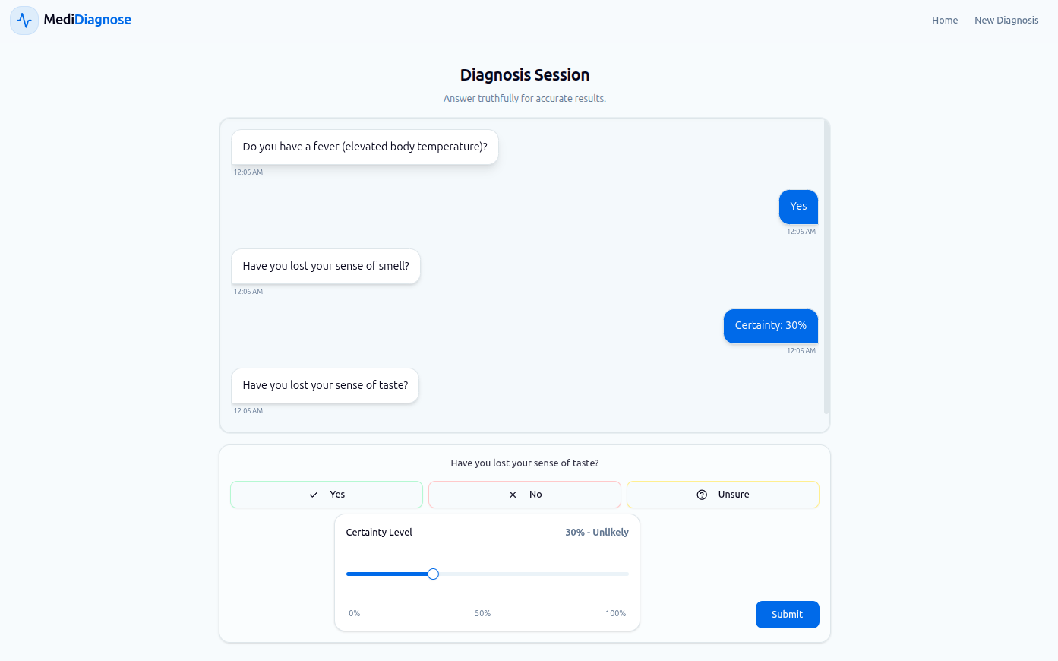
Our Solution
A USER-FRIENDLY, CHAT-BASED PORTAL FOR INSTANT PATIENT ACCESS.
MIMICS A CLINICIAN'S DECISION-MAKING PROCESS USING LOGICAL RULES.
HANDLES "FUZZY" INPUTS (E.G., "I'M 70% SURE") RATHER THAN JUST RIGID YES/NO ANSWERS.
PROVIDES EXPLAINABLE RESULTS FOR 6 DISTINCT VIRAL AND BACTERIAL RESPIRATORY CONDITIONS.
MediDiagnose

Slide 4
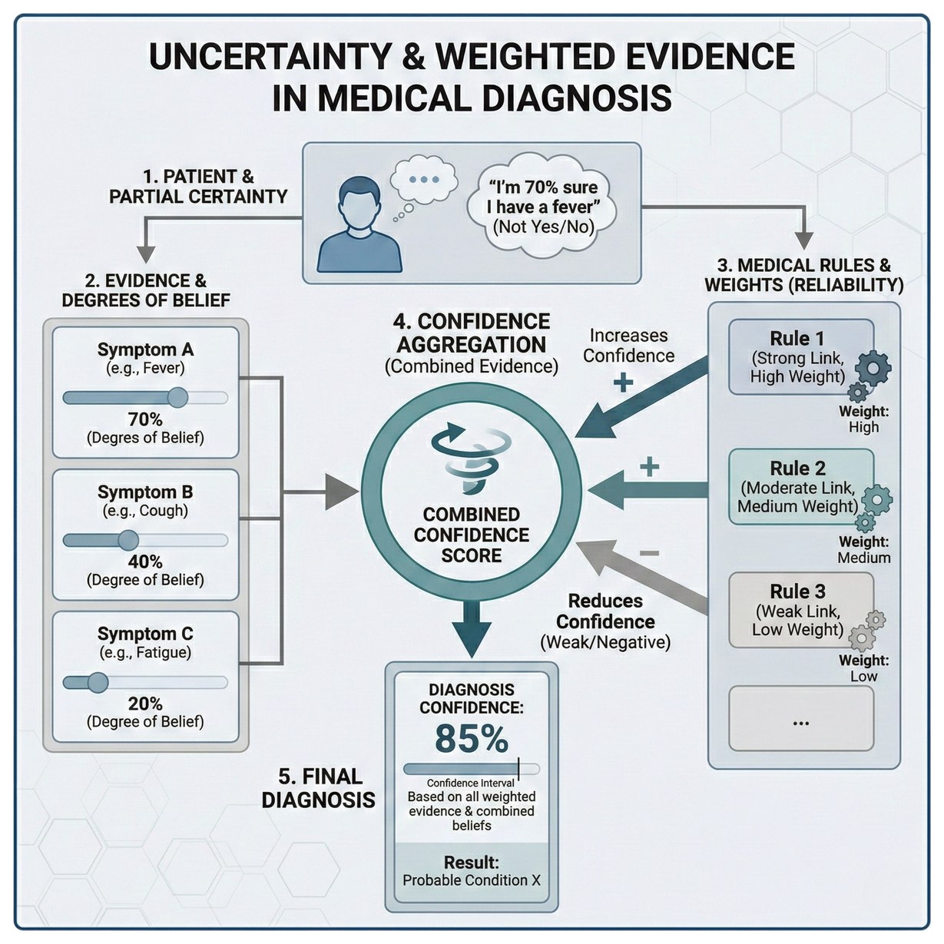
Handling Certainty Factors
PATIENTS ARE OFTEN PARTIALLY SURE, NOT YES/NO
EACH SYMPTOM CONTRIBUTES A DEGREE OF BELIEF.
MEDICAL RULES ARE NOT EQUALLY RELIABLE, SO EACH RULE HAS A WEIGHT
STRONG SYMPTOMS INCREASE CONFIDENCE, WEAK OR NEGATIVE ONES REDUCE IT
FINAL DIAGNOSIS IS THE COMBINED CONFIDENCE FROM ALL EVIDENCE
MediDiagnose

Slide 5
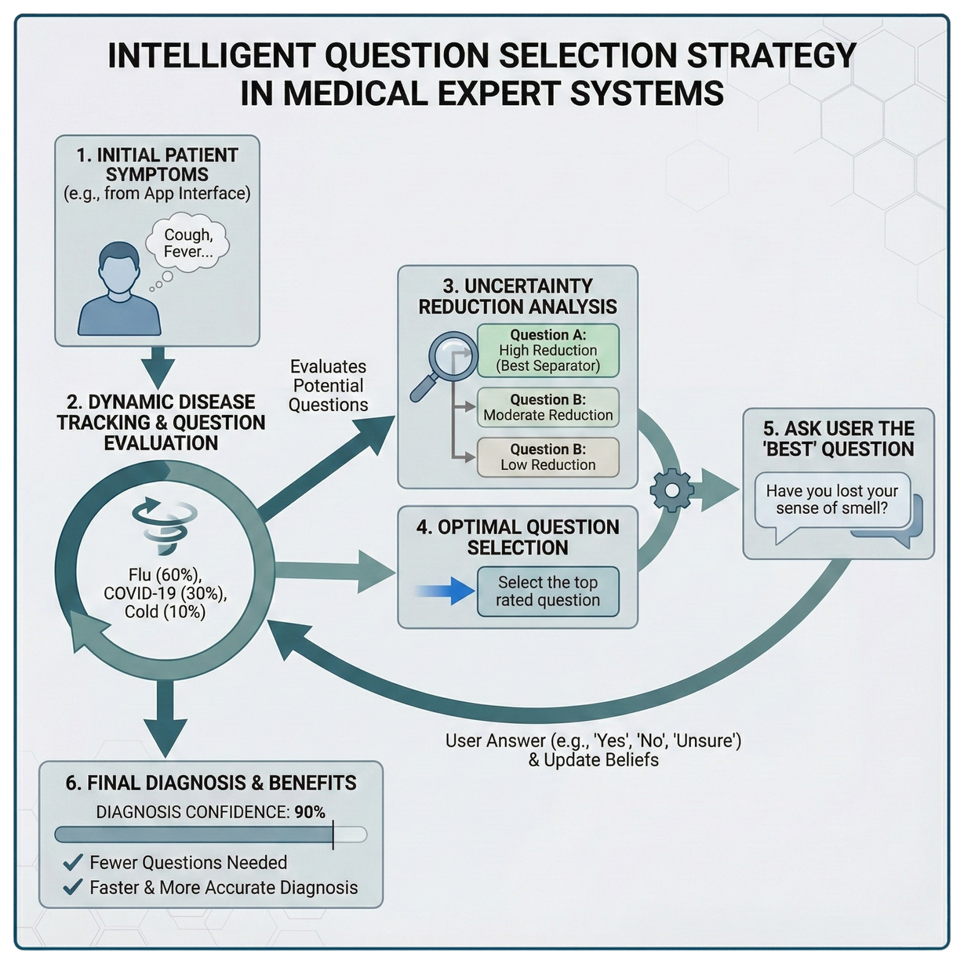
Information Gain
THE SYSTEM DOES NOT ASK SYMPTOMS RANDOMLY
IT TRACKS THE MOST LIKELY DISEASES SO FAR
EACH POSSIBLE QUESTION IS EVALUATED BY HOW MUCH IT REDUCES UNCERTAINTY
QUESTIONS THAT BEST SEPARATE DIAGNOSES ARE ASKED FIRST
THIS LEADS TO FEWER QUESTIONS AND A FASTER DIAGNOSIS
MediDiagnose

Slide 6
Project Demo
MediDiagnose

Slide 7
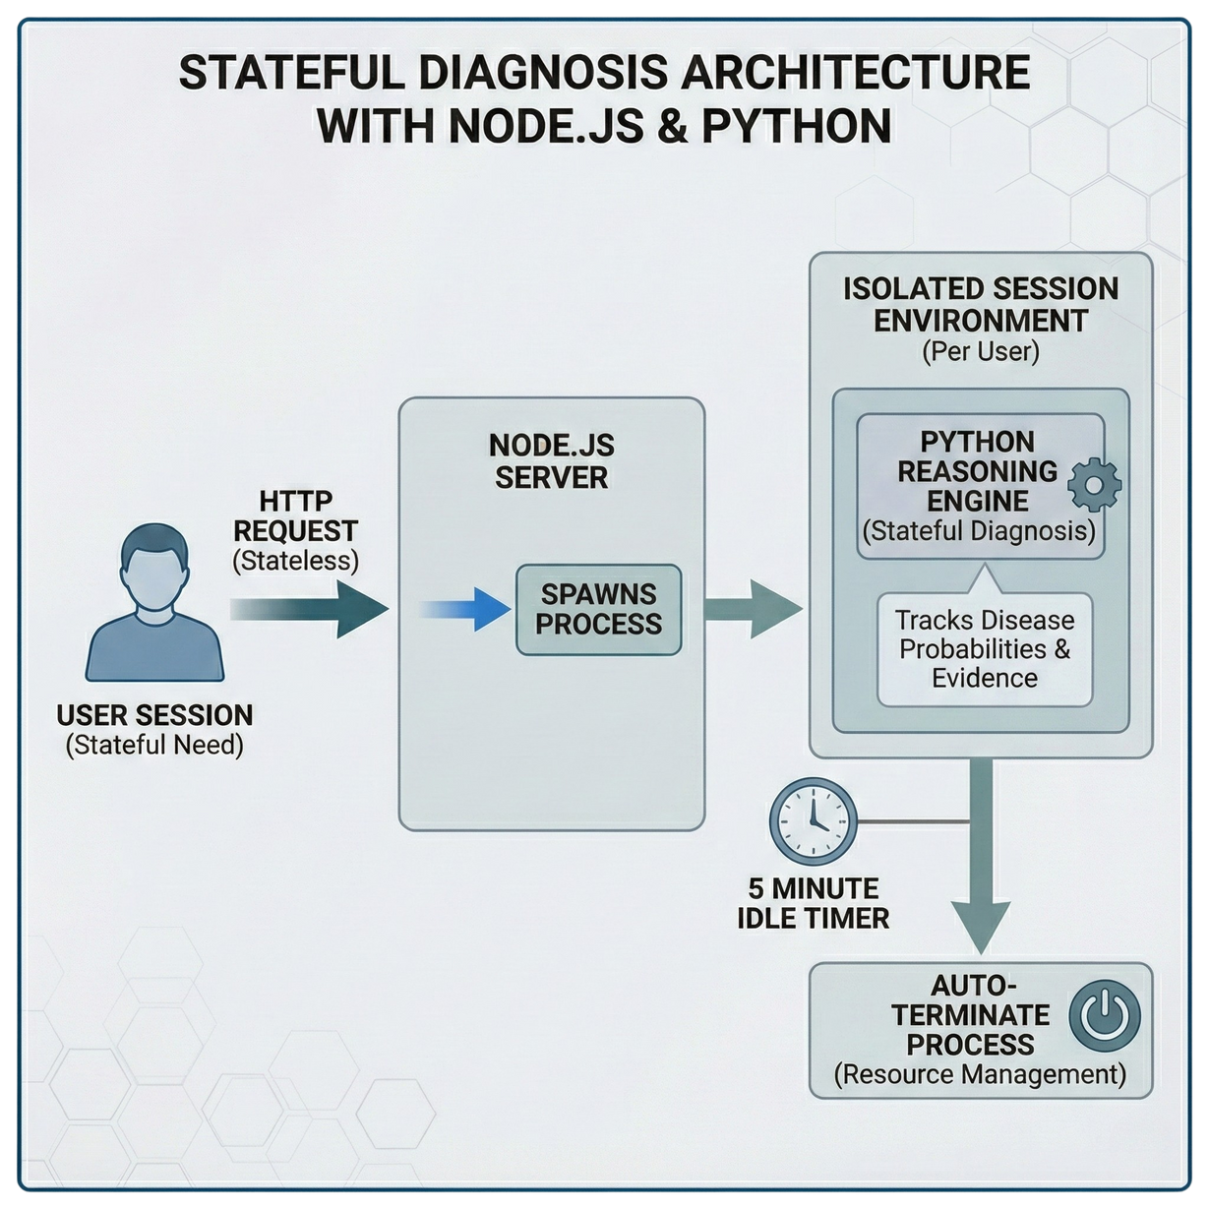
System Architecture
DIAGNOSIS IS STATEFUL; HTTP IS STATELESS
NODE.JS SPAWNS A PYTHON PROCESS PER SESSION
EACH USER GETS AN ISOLATED REASONING ENGINE
IDLE PROCESSES AUTO-TERMINATE AFTER 5 MINUTES
MediDiagnose

Slide 8
Code Explanation
MediDiagnose

Slide 9
Thank You
MediDiagnose

